Slide 1

Bayesian Network for Student Exam Score Prediction
Enrique Such Andreu and David Valls Lozano
Master’s Degree in Artificial Intelligence
Notes:
quique

Slide 2

Index
Introduction and Motivation
Abstract
Methodology
Dataset
Procesing and Discretization
Model Comparison
Elimination of Non-relevant variable
Conclusion
Notes:
quique

Slide 3
Introduction and Motivation
Importance of academic performance.
Use of Bayesian Networks to model uncertainty and causal relationships.
Comparison between expert knowledge and learned automatically.
Notes:
quique

Slide 4
Abstract
Bayesian Networks for modelling student exam performance.
Two models compared: an expert-defined causal structure and a structure learned automatically.
Notes:
david

Slide 5
Methodology
1. Data Loading and Analysis.
2. Variable Selection.
3. Preprocessing and Discretization.
4. Model Construction (Expert vs. Data).
5. Evaluation and Comparison.
6. Inference and Sensitivity Analysis.
Notes:
david

Slide 6

Dataset
Relevant variables:
hours_studied (continuous discretized)
sleep_hours (continuous discretized)
attendance_percent (continuous discretized)
previous_scores (continuous discretized)
exam_score (fail / pass / excellent)
Notes:
quique

Slide 7
Preprocessing and Discretization
Continuous predictors were discretized into low / medium / high.
Exam score recoded: fail (<50), pass (50–79), excellent (>=80).
Discretization choice affects probability estimation and inference.
Notes:
quique

Slide 8
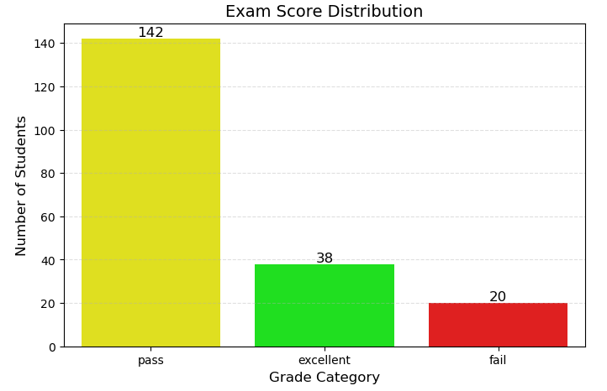
Exam Score Distribution
Notes:
quique

Slide 9
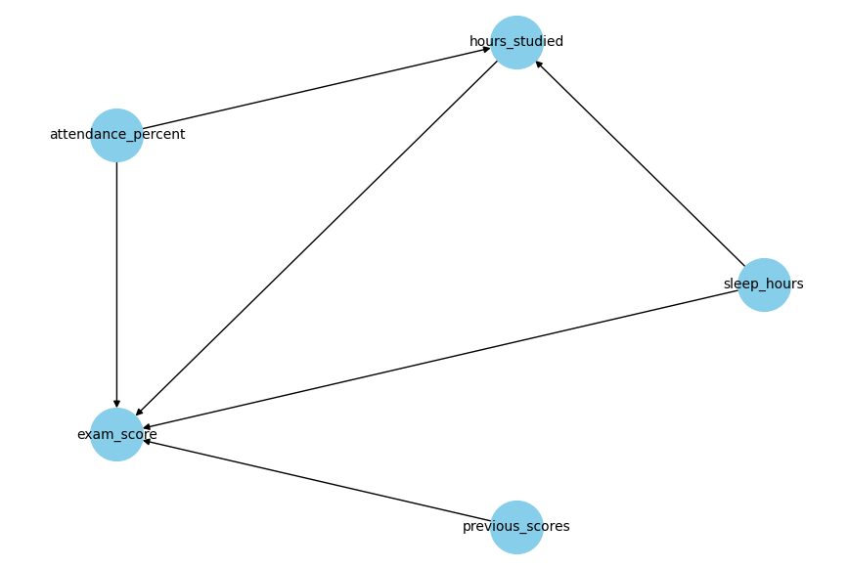
Expert-defined Bayesian Network
Notes:
david

Slide 10
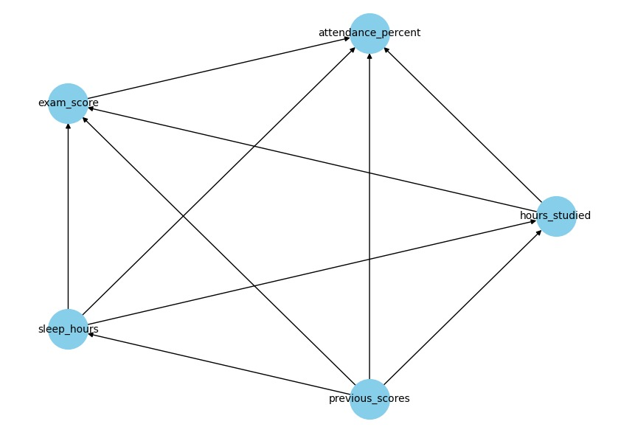
Data-driven Bayesian Network
Notes:
david

Slide 11
Model Comparison (BIC Score)
Models were compared using BIC.
Expert-defined model showed better BIC, indicating better trade-off between fit and complexity.
Data-driven model contains extra edges and reacts more strongly to evidence.
Notes:
quique

Slide 12
Comparison of Both Models
Model | BIC Score
Expert-driven | -1421.1342
Data-driven | -1528.4320
Since the BIC Score of the Expert-driven is higher, we deduce that this model fits the data better.
Notes:
quique

Slide 13
CPT Summary
Node | State1 | P1 | State2 | P2 | State3 | P3
hours_studied | low | 0.02 | medium | 0.129 | high | 0.402
previous_scores | low | 0.073 | medium | 0.13 | high | 0.355
attendance_percent | low | 0.162 | medium | 0.129 | high | 0.275
sleep_hours | low | 0.116 | medium | 0.217 | high | 0.231
Notes:
david

Slide 14
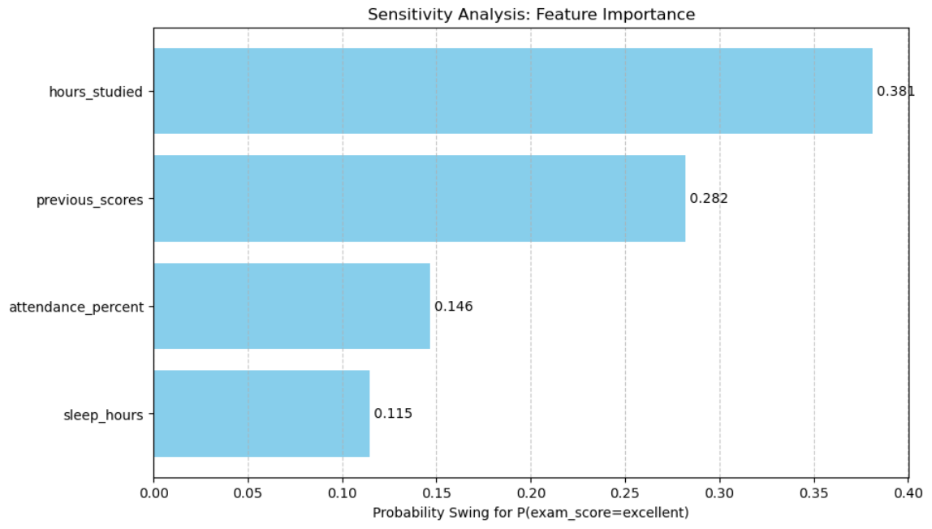
Sensitivity Analysis
Notes:
david

Slide 15
Elimination of Non-relevant Variable (sleep_hours)
Is the sleep_hours variable necessary?
Full model vs. Simplified model (without sleep).
The simplified model has a better BIC (-907 vs -1421).
Notes:
quique

Slide 16
Conclusions
The expert-defined BN is more interpretable and preferred for this dataset.
Automated structure learning may capture false correlations when data is limited or noisy.
The dataset had low exam scores originally. We edited them (fail/pass/excellent), which conditions the results.
Some variables had not enough influence, and the model performs better without them.
Notes:
david

Slide 17
Thank you / Questions

